Slide 1
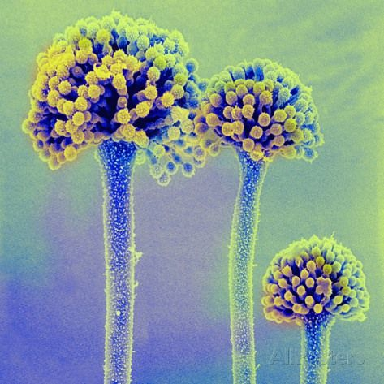
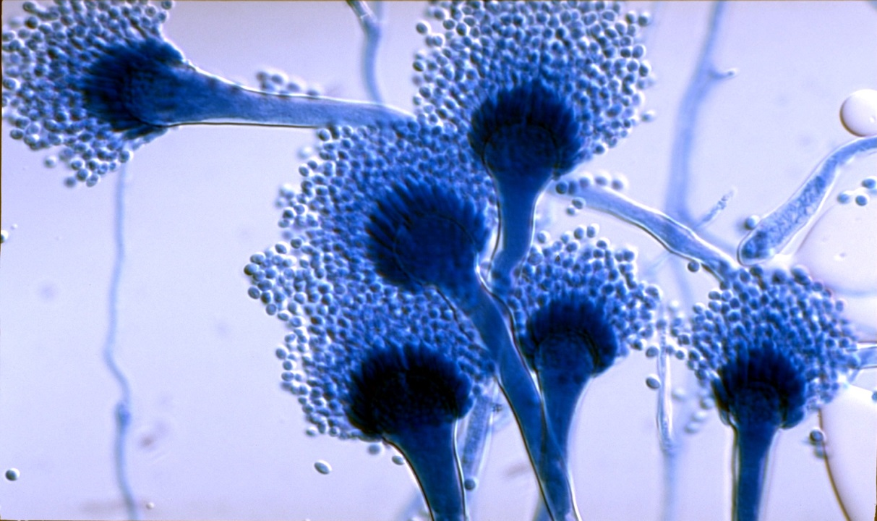
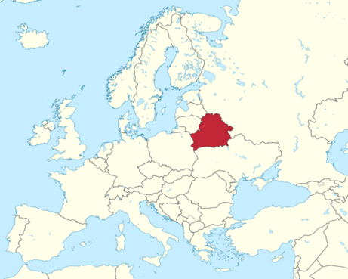
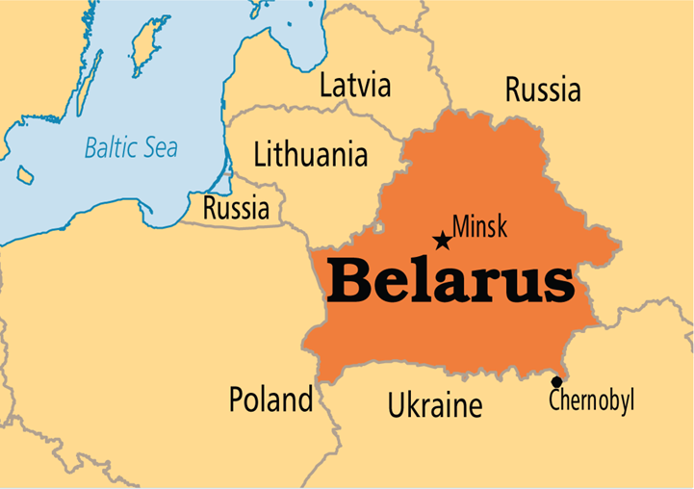
Estimate of the burden of serious fungal diseases in Belarus
Alena Skrahina¹, David W. Denning², Henadz Hurevich¹, Natalia Yatskevich¹
1. The Republican Research and Practical Centre for Pulmonology and TB, Minsk Belarus
2. The University of Manchester and The National Aspergillosis Centre in association with the LIFE program www.LIFE-Worldwide.org
Introduction
Fungal infections make a major contribution to human morbidity and mortality, as well as being the predominant pathogens of plants and contributing to more species extinctions than any other microorganism (Fisher et al.¹ cited by Brown et al.²). However, the impact of these diseases on human health is not widely appreciated.²
Invasive fungal diseases are associated with very high mortality rates. For example, the crude mortality rate of Candida bloodstream infections is 47–55%, which is higher than the mortality rate of the most merciless viral or bacterial sepsis.³ Untreated invasive aspergillosis, Pneumocystis pneumonia and cryptococcal meningitis are uniformly fatal. Over one million people every year die from fungal infections, and maybe as many as two million, as many or more than those dying from tuberculosis or malaria.² The current incidence of invasive fungal diseases is a consequence of significant growth of number of immunocompromised patients in recent decades. This is caused by significant burdens of immunosuppressive conditions such as HIV infection, cancer chemotherapy, autoimmune disorders, numerous targeted monoclonal antibody therapies affecting immune responses, prolonged stay in ICU and increasing number of transplant patients.^{4–6} This work aims to estimate serious fungal infection burdens in Bearus. No estimate of fungal infection burden has been made previously for Belarus. Such work is crucial to inform healthcare and research funding agencies and to prioritise funds to diagnose and treat fungal infections.
Belarus (Fig. 1) country economic (Table 1) and demographic (Table 2.) profile
Belarus is a country in Eastern Europe with a population of 9.570 million people (2016), Gross Domestic Product (GDP) per capita of $ 8014.3 (2014) and Total Health Expenditure – 5.69 % of GDP (2014).
Table 2.
Results
An estimated 822 have chronic pulmonary aspergillosis (CPA) after pulmonary tuberculosis (4,076 survivors in 2012) 50% of the total burden. Allergic bronchopulmonary aspergillosis (ABPA) and severe asthma with fungal sensitisation (SAFS) were estimated in 5,891 and 7,776 respectively, in 235,830 adult asthmatics. Among those 35,000 (2015) estimated to have HIV infection, of whom 7,152 are at risk of an opportunistic infections (OI), an estimated 2,460 develop oesophageal candidiasis, 196 develop Pneumocystis pneumonia (PCP) (6% rate) and 61 cryptococcal meningitis (1.7% rate) each year. Using a 5/100,000 rate, candidaemia is found in 476 patients (1,190 total invasive candidiasis) and 156 invasive aspergillosis. Recurrent vulvovaginal candidiasis (>4 episodes/year) is estimated to occur in 164,271 females. There are no incidence data on tinea capitis, fungal keratitis or mucormycosis.
Population | 9,570,376 (July 2016 est.)
Age structure | 0-14 years: 15.65% (male 770,014/female 727,338) 15-24 years: 10.68% (male 525,704/female 496,414) 25-54 years: 45.04% (male 2,118,447/female 2,191,694) 55-64 years: 13.95% (male 589,288/female 745,815) 65 years and over: 14.69% (male 448,135/female 957,527) (2016 est.)
Median age | total: 39.8 years; male: 36.8 years; female: 42.9 years (2016 est.)
Birth rate | 10.5 births/1,000 population (2016 est.)
Death rate | 13.3 deaths/1,000 population (2016 est.)
Net migration rate | 0.7 migrant(s)/1,000 population (2016 est.)
Urbanization | urban population: 76.7% of total population (2015) rate of urbanization: 0.05% annual rate of change (2010-15 est.)
Infant mortality rate | total: 3.6 deaths/1,000 live births; male: 4 /1,000; female: 3.2/1,000 (2016 est.)
Maternal mortality rate | 4 deaths/100,000 live births (2015 est.)
Life expectancy at birth | total population: 72.7 years; male: 67.2 years; female: 78.6 years (2016 est.)
Education expenditures | 5% of GDP (2014)
Health expenditures | 5.7% of GDP (2014)
Physicians density | 3.93 physicians/1,000 population (2013)
Table 4. Estimate the burden of serious fungal infections in Belarus.
Infection | Number of infections per underlying disorder per year |  |  |  |  | Total burden | Rate /100K
 | None | HIV/AIDS | Respiratory | Cancer | ICU
Oesophageal candidiasis | - | 2,460 | - | - | - | 2,460 | 26
Candidaemia | - | - | - | 335 | 143 | 478 | 5
Recurrent vaginal candidiasis (4x/year +) | 164,271 | - | - | - | - | 164,271 | 3,437
ABPA | - | - | 5,891 | - | - | 5,891 | 62
SAFS | - | - | 7,776 |  |  | 7,776 | 81
Chronic pulmonary aspergillosis | - | - | 1,644 | - | - | 1,664 | 60
Invasive aspergillosis | - | - |  | 57 | 99 | 156 | 1.6
Cryptococcal meningitis | - | 61 | - | - | - | 61 | 0.6
Pneumocystis pneumonia | - | 196 | - | - | - | 196 | 2.1
Total burden estimated | 164,271 | 2,717 | 15,311 | 392 | 242 | 182,953 | 3675.3
Rationale and purpose of the study
Invasive fungal infection diagnosis is rare in Belarus as the tools are unavailable in most centres and no data is collected. The burden of HIV and respiratory disease is high, notably tuberculosis TB, chronic obstructive pulmonary disease (COPD) and asthma. Here we estimate the burden of serious fungal infections in Belarus for the first time.
Table 3. Belarus disease burden (related to fungal infections)
HIV/AIDS - adult prevalence rate | 0.64% (2015 est.)
HIV/AIDS - people living with HIV/AIDS | 35,200 (2015 est.)
HIV/AIDS - deaths | 1,000 (2015 est.)
COPD prevalence | 511,735 (2015 est.)
COPD extrapolated undiagnosed prevalence | 568,594 (2015 est.)
Asthma prevalence | 235,830 (2014 est.)
TB | Number /K | /100 000
Incidence (includes HIV+TB) | 5.2 (3.9–6.8) | 55 (41–71)
HIV
Fig. 1. Belarus in Europe
TB
MDR-TB
Asthma
Table 1. Country economic profile
Conclusions
The present study indicates that at least 2% (182,953) of the population is affected by a serious fungal infection annually. This problem is serious enough to warrant the first epidemiological studies of fungal disease in Belarus.
Region | Eastern Europe
Surface area (sq km) | 207600
Population (proj., 000) | 9 570 (2016)
Pop. density (per sq km) | 46.7 (2016)
Capital city | Minsk
COPD

